Slide 1


Grow your sustainable lifestyle!
Created by:
Ruocheng Han
Rangsiman Ketkaew
Lukas Schreder
Eva Vandaele

Slide 2
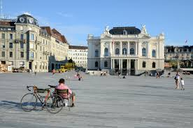









MICHOICE
One Tree reduce 21 kg CO₂ per year, so we have…

Slide 3
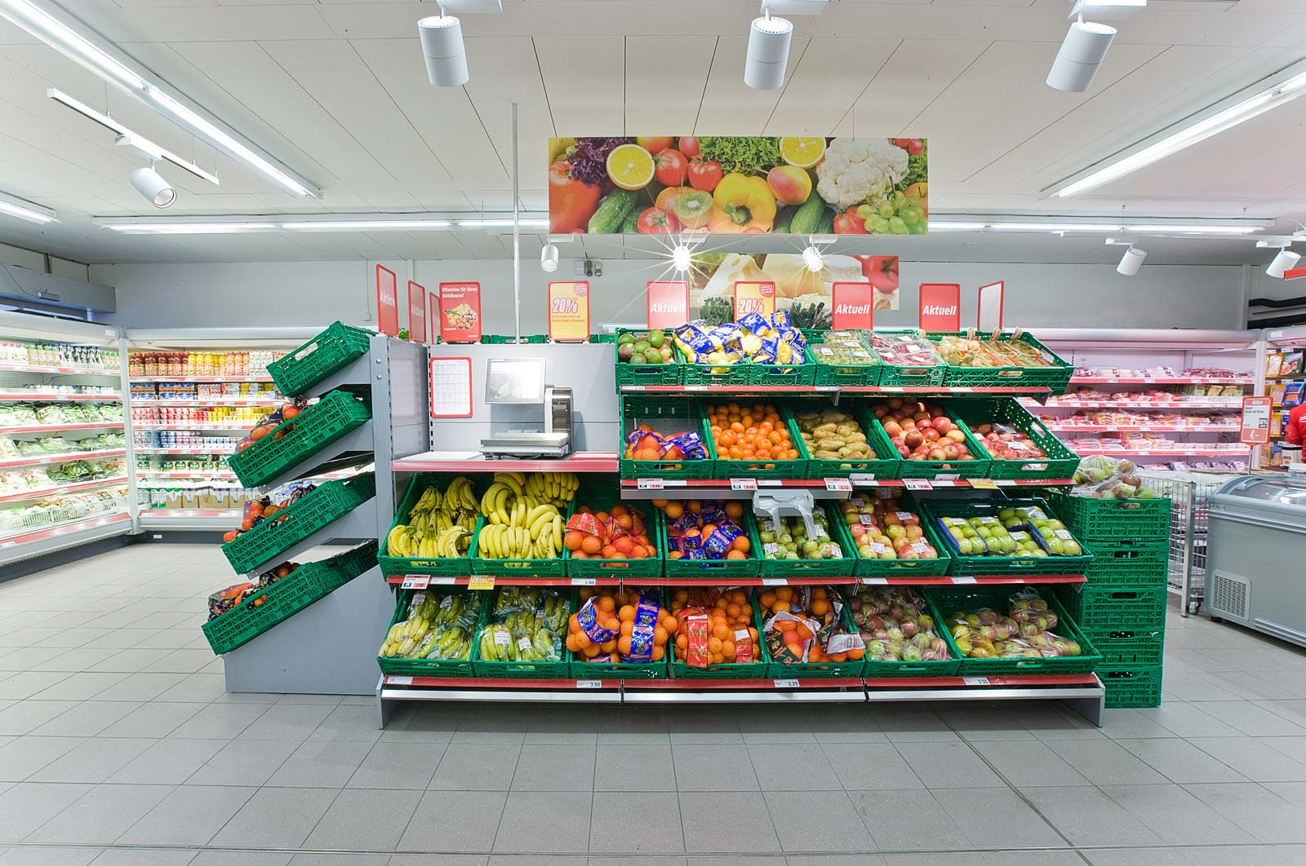
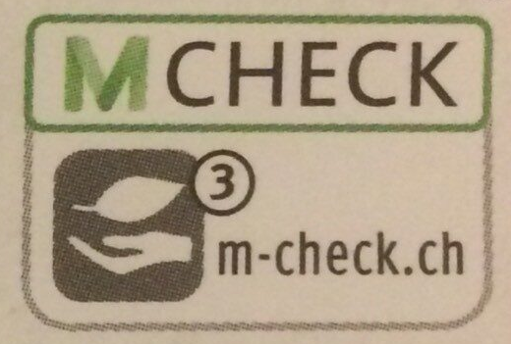

MICHOICE

Slide 4
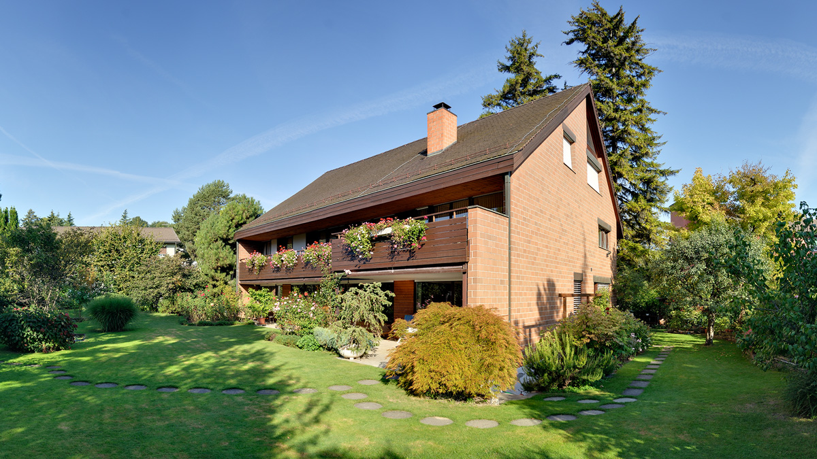




MIGROW

Slide 5
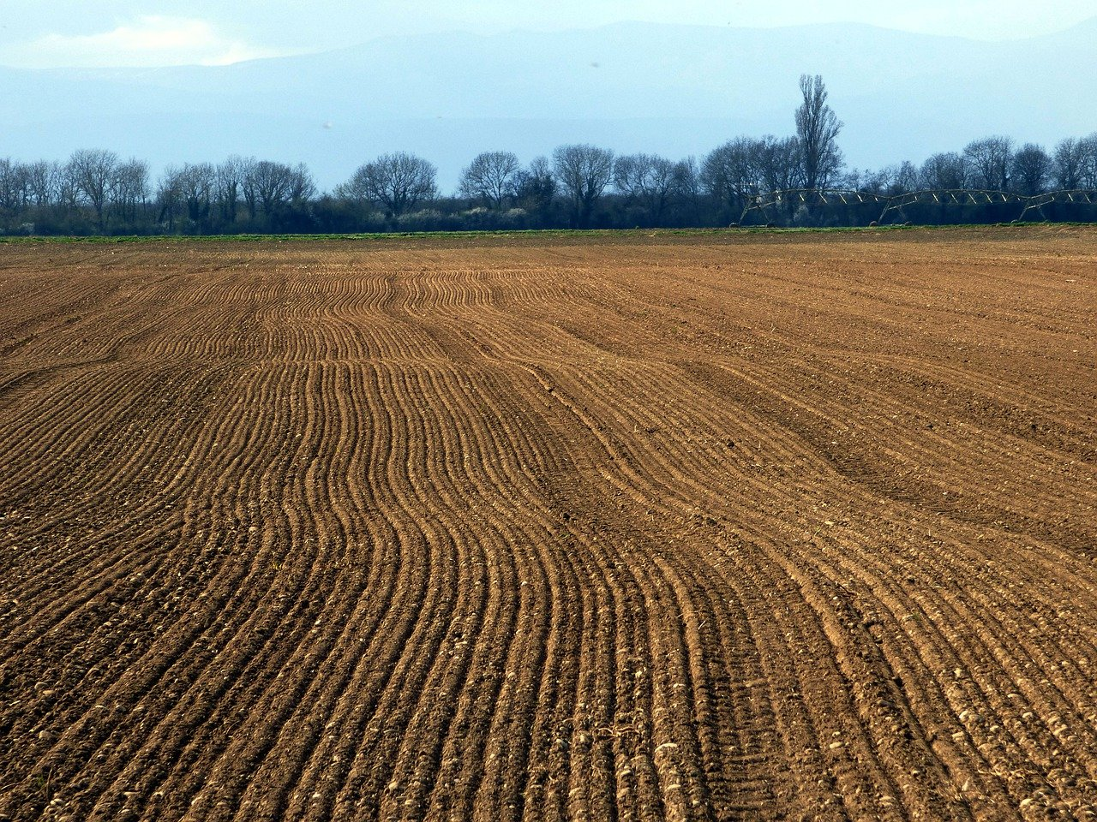







MIGROW

Slide 6
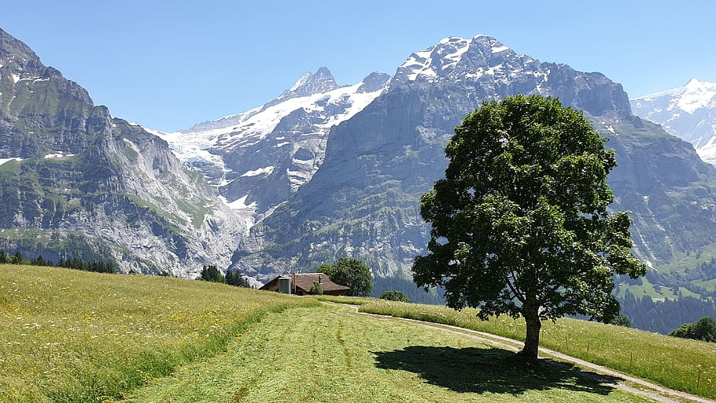

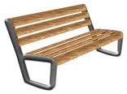


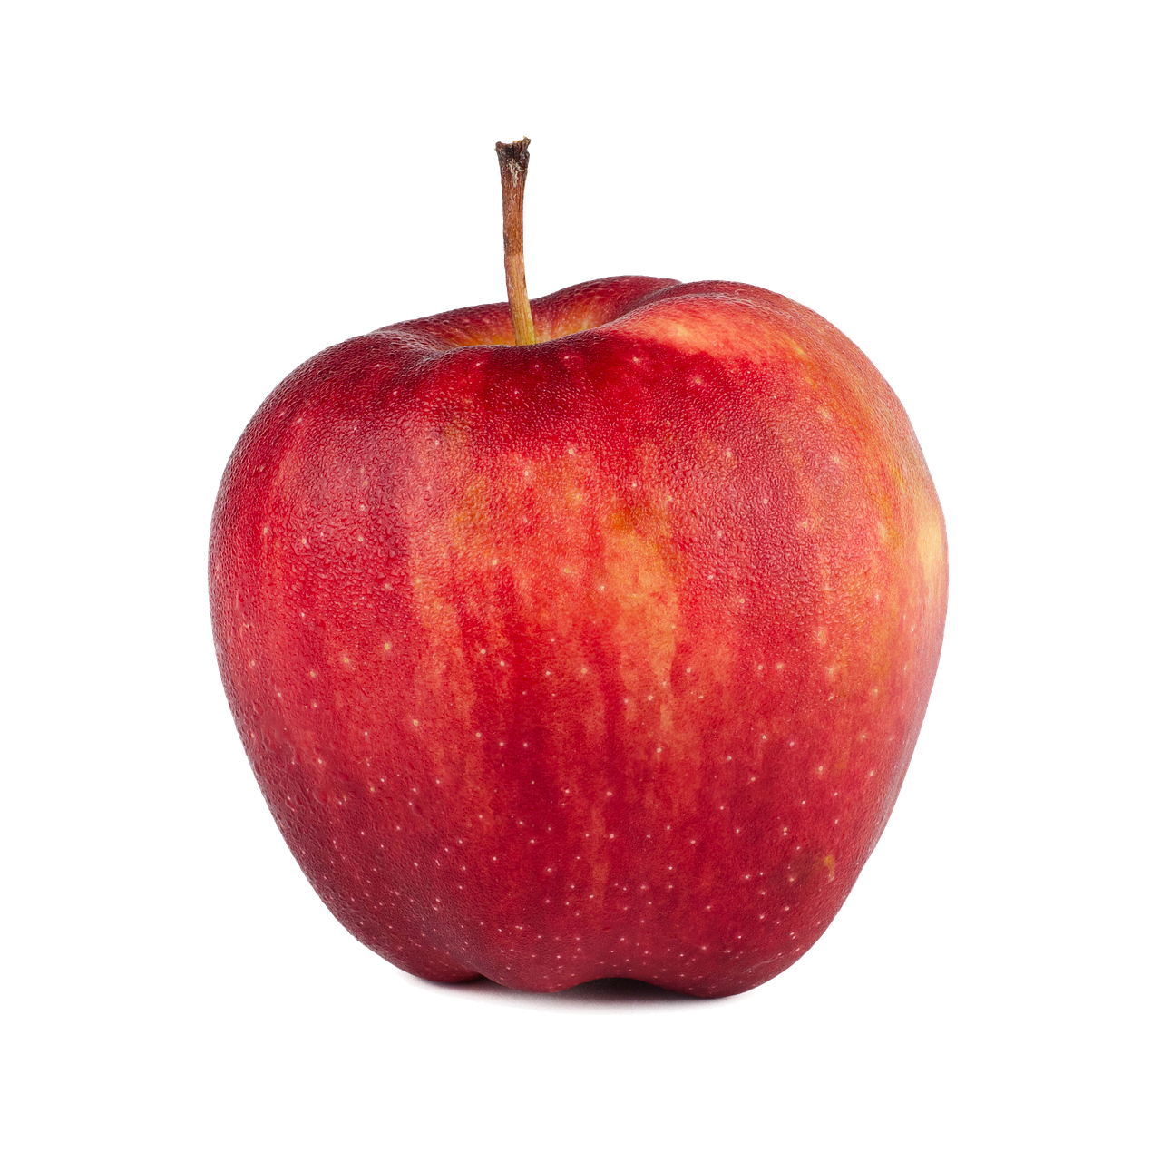
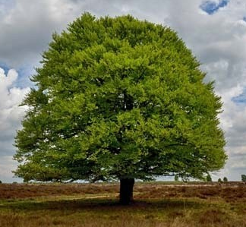

MIGEFÜHL

Slide 7
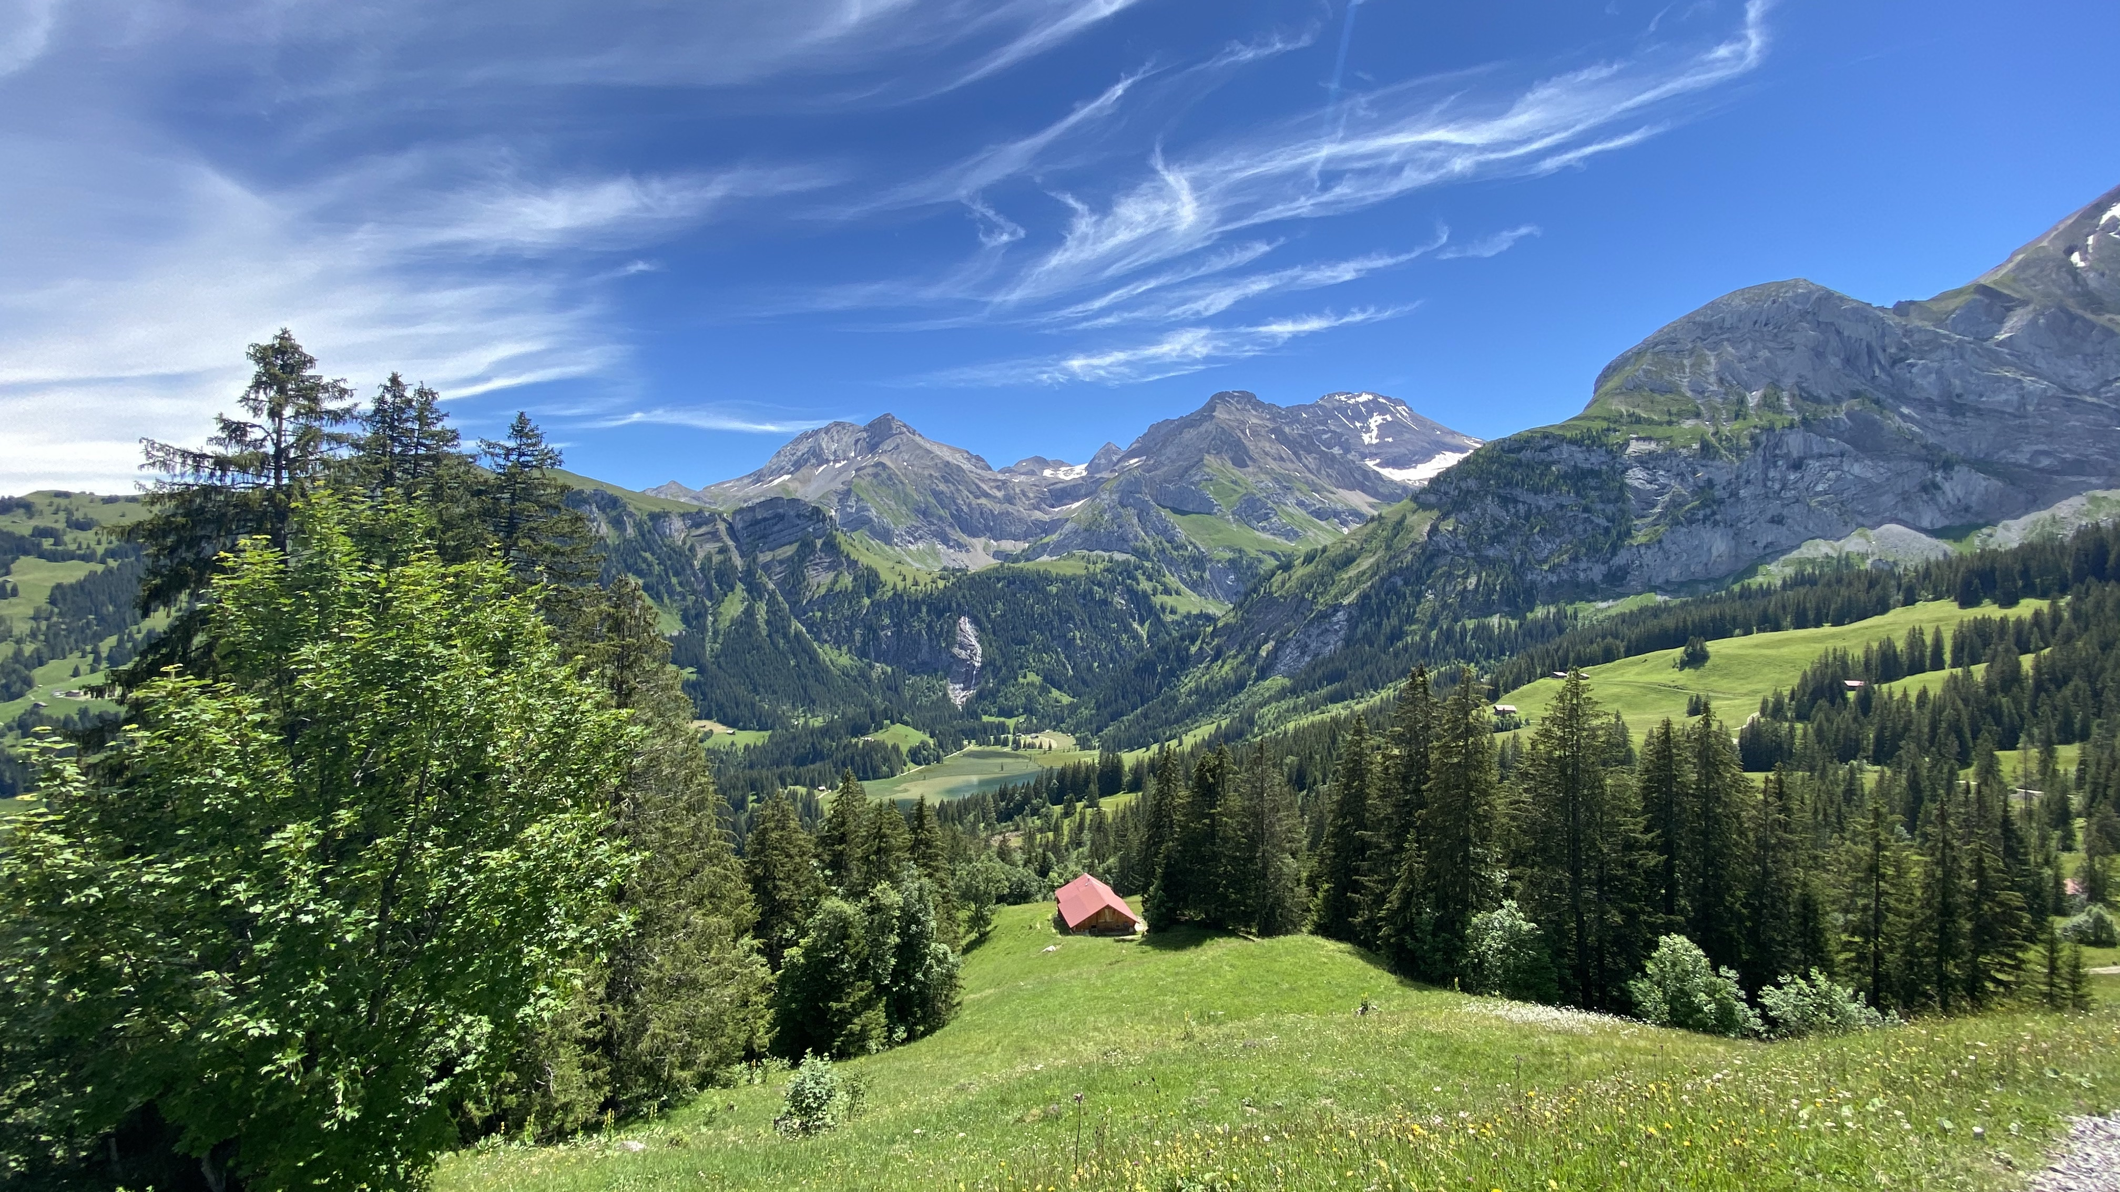





MIGEFÜHL

Slide 8
Grow your sustainable lifestyle!
Created by:
Ruocheng Han
Rangsiman Ketkaew
Lukas Schreder
Eva Vandaele

